Slide 1
Time Lag Model of Population Growth
Dr Mohammed Shoeb
Assistant Professor
Department of Zoology
Govt. Dr WW Patankar Girl’s PG College, Durg

Slide 2
Contents
Introduction
Factors Causing Time Lag
Impacts of Time lag in Population Models
Time Lag Equation and Graphs
References

Slide 3
Introduction
A time lag model of population growth is a model that can be used to study the impact of time lags on population dynamics.

Slide 4
Factors Causing Time Lag
Predator-prey interactions: Time lags in a predator's response to changes in prey abundance, or in the predator's physiological food requirements, can affect the form of oscillations in a predator-prey system

Slide 5
Factors Causing Time Lag
Environmental heterogeneity: Time lags can be affected by the heterogeneity of the environment, such as the availability of prey refuges.
Variable environment: Time lags can have a significant evolutionary role in populations that live in variable environments, such as those that are influenced by predators or subject to fluctuating environments.

Slide 6
Impacts of time lags in population models
Destabilizing equilibrium: A time lag in the death rate of predators can destabilize the equilibrium point and cause oscillations that can grow so wide that predators become extinct.
Reversing the outcome of competition: Time lag terms can reverse the outcome of competition in some cases,
Quantifying the transition between stable states: The mean first-passage time can be calculated to quantify the transition between stable states in a population model.

Slide 7
In a continuously growing population, adding new individuals into the population causes a continuous decrease in the per capita rate of population growth [(1/N)(dN/dt)]
However, in many populations there are time lags (τ) in response to changes in population size.

Slide 8



Time Lags
t
t+1
t+2
t+3
t+4
^{𝒅𝑵} = 𝒓𝑵 𝟏 − ^{𝑵𝒕−𝑟}
𝒅𝒕 𝑲
τ = time lag

Slide 9
𝒅𝑵/𝒅𝒕 = 𝒓𝑵 (𝟏 − 𝑵_{𝒕−𝝉}/𝑲)
τ = time lag
Two things will affect this equation.
The length of the time lag (τ)
The response time of the population – this is inversely related to the intrinsic rate of increase (i.e. 1/r).
Ratio of the time lag to the response time 𝝉 𝟏/𝒓 , (which is simply rτ) controls population growth.

Slide 10
If rτ is small (between 0 to 0.368) the population increases smoothly to a carrying capacity.
If rτ is moderate (0.368 to 1.570) the population first overshoots then undershoots carrying capacity, followed by dampening oscillation to reach carrying capacity over time.
If rτ is large (>1.570) the population goes into a stable limit cycle of oscillations above and below carrying capacity that go on indefinitely.

Slide 11
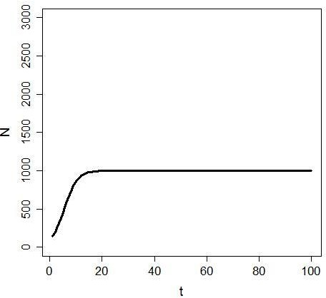
Time lags (continuous population)
^{𝑑𝑁} = 𝑟𝑁 1 − ^{𝑁𝑡−𝑐}
𝑑𝑡 𝐾
r <- 0.4
K <- 1000
τ <- 0
t <- seq(1,100,1)
N0 <- 100
r <- 0.4
K <- 1000
tau <- 0
rtau <- r*tau
N <- seq(0,length(t),1)
N[1]<-N0
lambda <- exp(r)
for(ts in t){
etau <-
tau
if(ts <=
tau) etau <- 0
N[ts+1] <- lambda*N[ts]/(1+((N[ts- etau]*(lambda-1))/K))
}

Slide 12
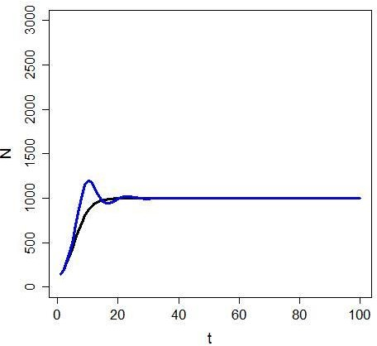
Time lags (continuous population)
^{𝑑𝑁} = 𝑟𝑁 1 − ^{𝑁𝑡−𝑐}
𝑑𝑡 𝐾
 |  | 𝑟
0 < rτ | < | _{𝟏/𝒓}, = rτ 0.368 < |  | rτ < 1.57
r | <- | 0.4
K | <- | 1000
τ | <- | 0, rτ | = | 0
τ | <- | 2, rτ | = | 0.8

Slide 13
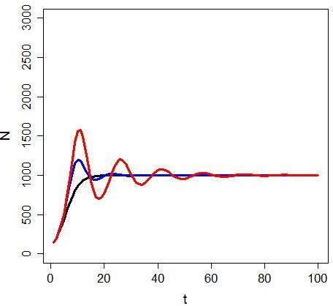
Time lags (continuous population)
^{𝑑𝑁} = 𝑟𝑁 1 − ^{𝑁𝑡−𝑐}
 | 𝑑𝑡 | 𝑟 |  | 𝐾
0 < | rτ < | _{𝟏/𝒓}, = rτ 0.368 < |  | rτ < 1.57
 | r <- | 0.4
 | K <- | 1000
 | τ <- | 0, rτ | = | 0
 | τ <- | 2, rτ | = | 0.8
 | τ <- | 3, rτ | = | 1.2

Slide 14
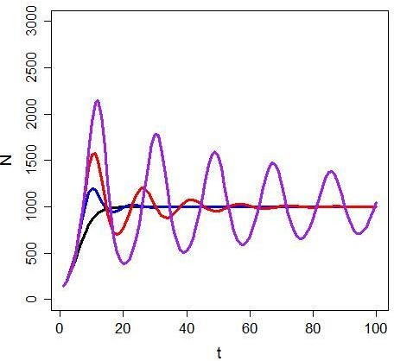
Time lags (continuous population)
^{𝑑𝑁} = 𝑟𝑁 1 − ^{𝑁𝑡−𝑐}
 | 𝑑𝑡 | 𝑟 |  | 𝐾
0 < | rτ < | _{𝟏/𝒓}, = rτ 0.368 < |  | rτ < 1.57
 | r <- | 0.4
 | K <- | 1000
 | τ <- | 0, rτ | = | 0
 | τ <- | 2, rτ | = | 0.8
 | τ <- | 3, rτ | = | 1.2
 | τ <- | 4, rτ | = | 1.6

Slide 15
References
Time-lag models of population growth
Cambridge University Press. Eric Renshaw
A simulation study of a time lag population model. Hal Caswell
The effect of a time-delay in a predator-prey model. Roger Arditi, Jean-Marie Abillon, Jorge Vieira da Silva. Mathematical Biosciences
Impact of time delay on population model with Allee effect. Dongxi Li, Yachao Yang
Communications in Nonlinear Science and Numerical Simulation

